Slide 1
Green university of Bangladesh
Computer science and engineering
Name: Jakirul Islam
ID : 193002101
Dept of CSE
Topic : Binary search trees

Slide 2
Outlines:
Binary Tree and Complete Binary Tree
Traversal Operations
Applications of BST

Slide 3
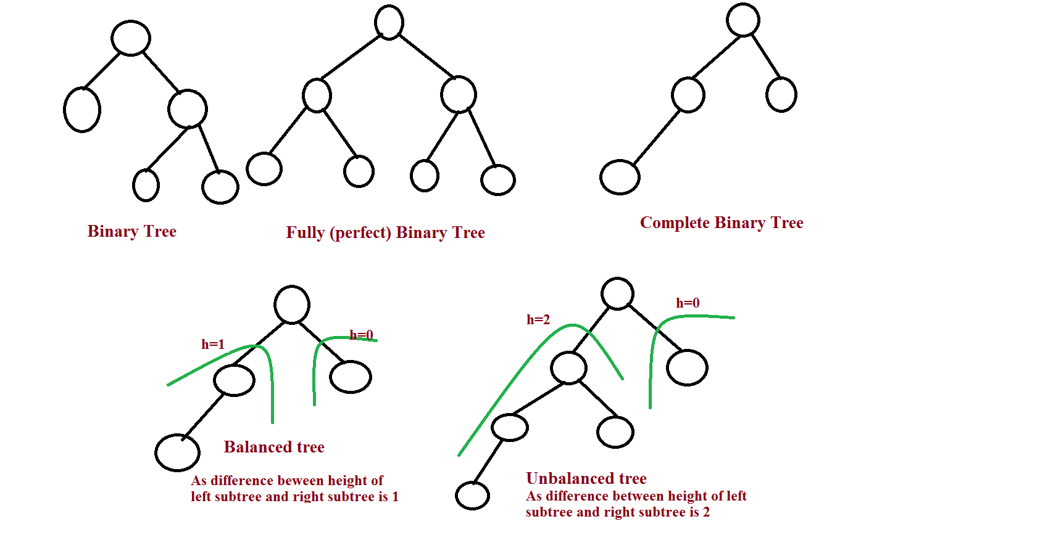
Binary Tree and Complete Binary Tree:
Binary Tree(BT) is a tree in which each node contains at most two child nodes(left child and right child).
A complete binary tree is a binary tree in which every node contains exactly two child nodes except the leaf nodes.

Slide 4
Traversal Operations:
Pre-order Traversal
Process the root node
Perform preorder traversal of left subtree
perform preorder traversal of right subtree
In-order Traversal
Perform In order traversal of left subtree
Process the root node
Perform In order traversal of right subtree
Post-order Traversal
Perform Post order traversal of left subtree
Perform Post order traversal of right subtree .
Process the root node

Slide 5
Traversal Operation – Examples
Inorder Traversal : 1 3 5 6 8 9 10
Preorder Traversal : 6 3 1 5 9 8 10
Postorder traversal :1 5 3 8 10 9 6
6
3
9
1
5
8
10

Slide 6
Applications of BST :
Used in many search applications where data is constantly entering/leaving, such as the map and set objects in many languages' libraries.
Storing a set of names, and being able to lookup based on a prefix of the name. (Used in internet routers.)
Storing a path in a graph, and being able to reverse any subsection of the path in O(log n) time. (Useful in travelling salesman problems).
Finding square root of given number
allows you to do range searches efficiently.

Slide 7


Slide 8


